Slide 1
Medicare Advantage: Food Access Program
Charlie Jubera

Slide 2
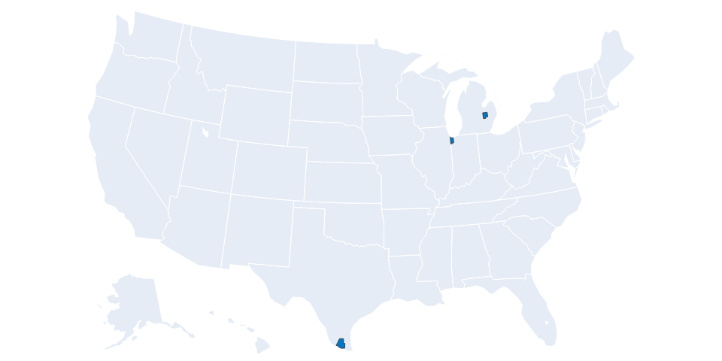
Targeting 3 counties will reach 362,726 people and save $31.2M annually in healthcare costs.
Genesee, MI
Lake, IN
Hidalgo, TX

Slide 3
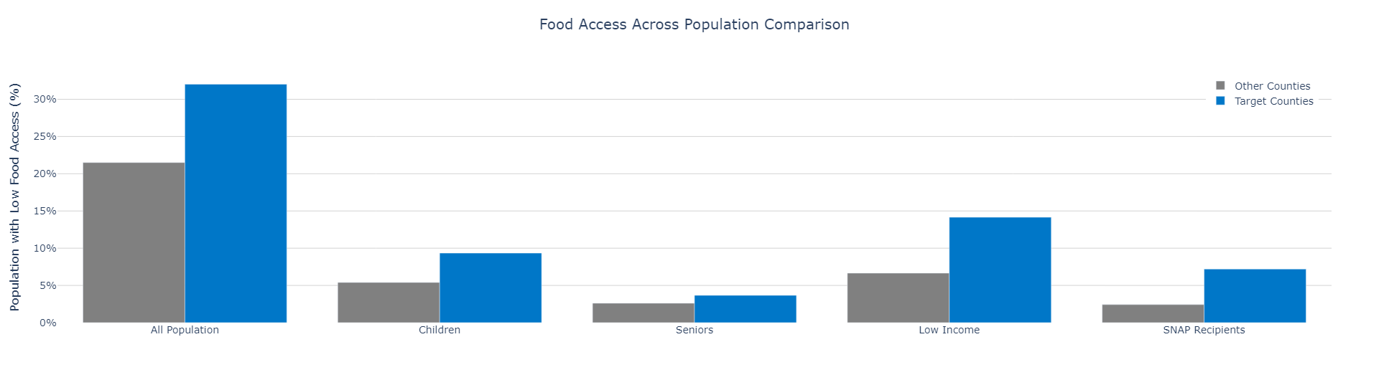
Target Counties
Hidalgo County, TX
Genesee County, MI
Lake County, IN
Combined low-access population (2020 projection): 643,374 people

Slide 4
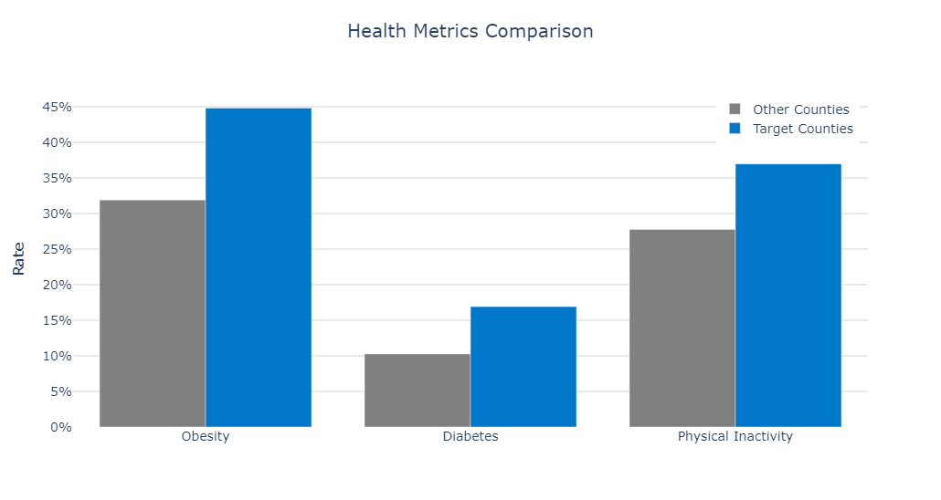
Health Impact
Higher obesity rates in target counties
Diabetes prevalence exceeds other counties' rates
Physical inactivity indicating barriers to healthy lifestyles

Slide 5
Expected Engagement
County | Low Access Population | Engagement Rate | Total Engagement
Hidalgo, TX | 302,459 | 54.7% | 165,349
Lake, IN | 212,729 | 54.2% | 115,255
Genesee, MI | 128,185 | 64.1% | 82,122
Total | 643,373 | 56.4% | 362,726

Slide 6
Projected Impact
Health Improvements
4,877 fewer cases of obesity
1,840 fewer cases of diabetes
Estimated Annual Cost Savings
$9,077,164 saved from reduced obesity-related costs
$22,129,341 saved from reduced diabetes-related costs
Total Annual Savings
$31,206,505 in combined healthcare cost reductions

Slide 7
Q&A
Thank you!

